Slide 1
Chapter 7: Entity-Relationship Model

Slide 2
Chapter 7: Entity-Relationship Model
Design Process
Modeling
Constraints
E-R Diagram
Design Issues
Weak Entity Sets
Design of the Bank Database
Reduction to Relation Schemas

Slide 3
Design Phases
The initial phase of database design is to characterize fully the data needs of the prospective database users.
Next, the designer chooses a conceptual schema (also called conceptual data model) that translates these requirements into high-level description of a business's informational needs.
The entity-relationship model is typically used to represent the conceptual design
It specifies the entities that are represented in the database, the attributes of the entities, the relationships among the entities, and constraints on the entities and relationships.
Notes:
3

Slide 4
Design Phases (Cont.)
The process of moving from an abstract data model to the implementation of the database proceeds in two final design phases.
In the logical-design phase, the designer maps the high-level conceptual schema onto the implementation data model of the database system that will be used. The implementation data model is typically the relational data model, and this step typically consists of mapping the conceptual schema defined using the entity-relationship model into a relation schema.
Finally, the designer uses the resulting system-specific database schema in the subsequent physical-design phase, in which the physical features of the database are specified. These features include the form of file organization and choice of index structures.
Notes:
4

Slide 5
ER model -- Database Modeling
The ER data mode was developed to facilitate database design by allowing specification of a conceptual schema that represents the overall logical structure of a database.
The ER model is very useful in mapping the meanings and interactions of real-world enterprises onto a conceptual schema.
The ER data model employs three basic concepts:
entity sets,
relationship sets,
attributes.
The ER model also has an associated diagrammatic representation, the ER diagram, which can express the overall logical structure of a database graphically.

Slide 6
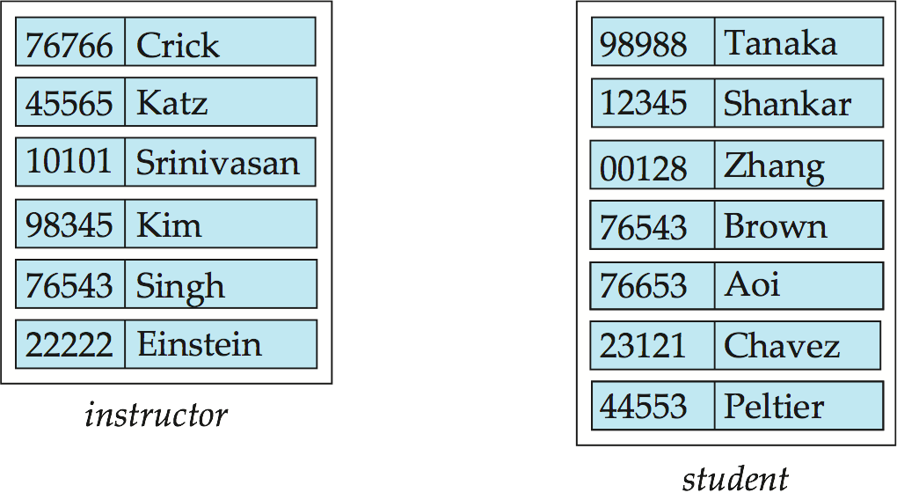
Entity Sets
An entity is a “thing” or “object” in the real world that is distinguishable from all other objects. For example, each person in a university is an entity.
An entity may be concrete, such as a person or a book, or it may be abstract, such as a course offering, or a flight reservation.
An entity set is a set of entities of the same type that share the same properties. The set of all people who are instructors at a given university, for example, can be defined as the entity set instructor. Similarly, the entity set student might represent the set of all students in the university.

Slide 7
Attributes
An entity is represented by a set of attributes that are descriptive properties possessed by each member of an entity set.
Possible attributes of the instructor entity set are ID, name, dept_name, and salary.
Possible attributes of the course entity set are course_id, title, dept_name, and credits.
Each entity has a value for each of its attributes. For instance, a particular instructor entity may have the value 101 for ID, the value Tian for name, the value Computer Science for dept_name, and the value 125000 for salary.
A subset of the attributes form a primary key of the entity set that can be used to uniquely identify each member of the set.

Slide 8
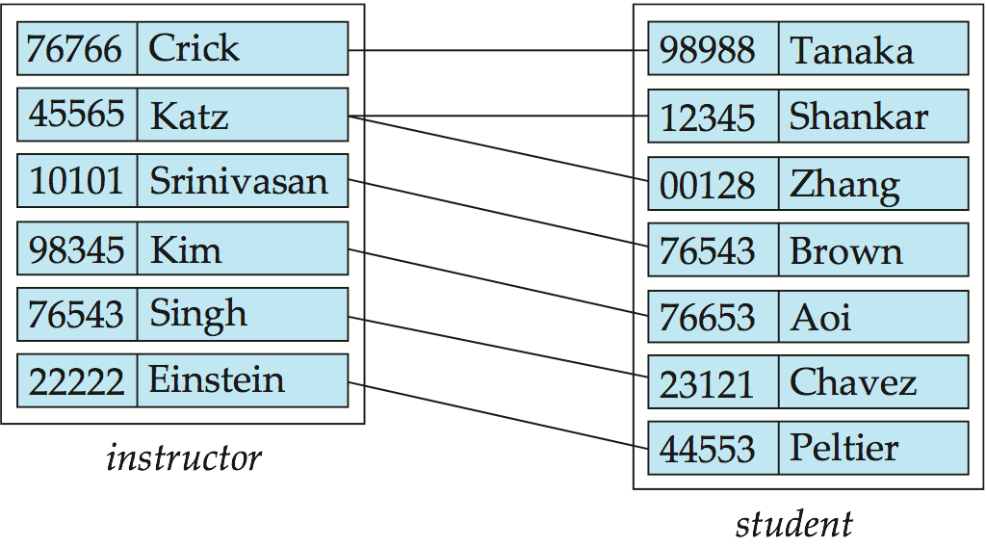
Relationship Sets
A relationship is an association among several entities. For example, we can define a relationship advisor that associates instructor Srinivasan with student Brown.
A relationship set is a set of relationships of the same type. We can define the relationship set advisor to denote the association between instructors and students as shown in the figure below.

Slide 9
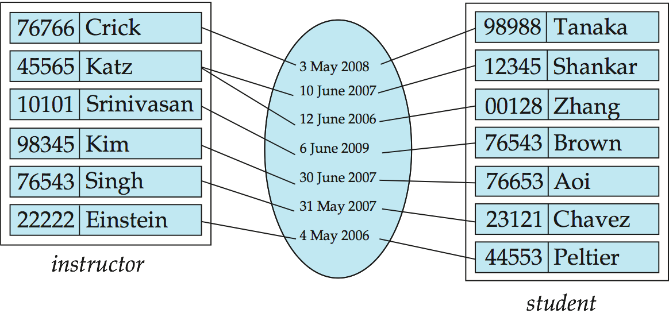
Relationship Sets (Cont.)
An attribute can also be associated with a relationship set.
For instance, the advisor relationship set between entity sets instructor and student may have the attribute date which tracks when the advisor started advising the student.

Slide 10
Degree of a Relationship Set
The number of entity sets that participate in a relationship set is the degree of the relationship set.
A binary relationship set is of degree 2; a ternary relationship set is of degree 3.
Most relationship sets in a database system are binary.
Example, advisor relationship set
Relationships between more than two entity sets are rare but may exist.
Example: students work on research projects under the guidance of an instructor.
We relate the three entity sets through the relationship set proj_guide, which indicates that a particular student is guided by a particular instructor on a particular project.

Slide 11
Attribute Domain
Domain of an attribute is a set of permitted values for that attribute.
The domain of attribute course_id might be the set of all text strings of a certain length.
Similarly, the domain of attribute semester might be strings from the set { Fall, Winter, Spring, Summer }.

Slide 12
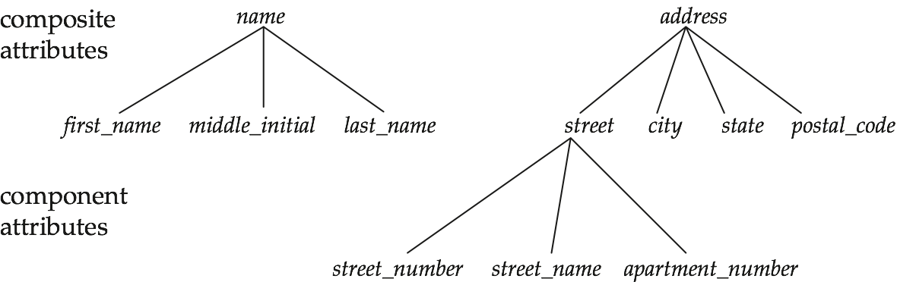
Attribute Types
Simple and composite attributes.
Simple attributes cannot be divided into subparts whereas composite attributes can be divided into subparts (that is, other attributes).
The address can be defined as a composite attribute consisting of the simple attributes street, city, state, and zip code.
Composite attributes help us to group together related attributes, making the modeling cleaner.

Slide 13
Attribute Types
Single-valued and multivalued attributes
Single-valued attributes such as student_ID have a single value for a particular entity.
There may be instances where an attribute has a set of values for a specific entity such as the attribute phone_number. An instructor may have zero, one, or several phone numbers
As another example, we could add to the instructor entity set an attribute dependent_name listing all the dependents. This attribute would be multivalued, since any particular instructor may have zero, one, or more dependents.
To denote that an attribute is multivalued, we enclose it in braces, for example {phone_number} or {dependent_name}.
Where appropriate, upper and lower bounds may be placed on the number of values in a multivalued attribute. For example, a university may limit the number of phone numbers recorded for a single instructor to two.

Slide 14
Attribute Types
Derived attributes
Can be computed from other attributes.
Example:
age, given date_of_birth
The number of students that an instructor advises can be computed by counting the number of student entities associated with the professor.
The value of a derived attribute is not stored but is computed when required.
Null value
An attribute takes a null value when an entity does not have a value for it.
For instance, middle_name

Slide 15
Constraints
An E-R model may define certain constraints to which the contents of a database must conform.
We will look at two such constraints - mapping cardinalities and participation constraints.

Slide 16
Mapping Cardinalities
Mapping cardinalities express the number of entities to which another entity can be associated via a relationship set.
For a binary relationship set, the mapping cardinality must be one of the following types:
One to one
One to many
Many to one
Many to many

Slide 17
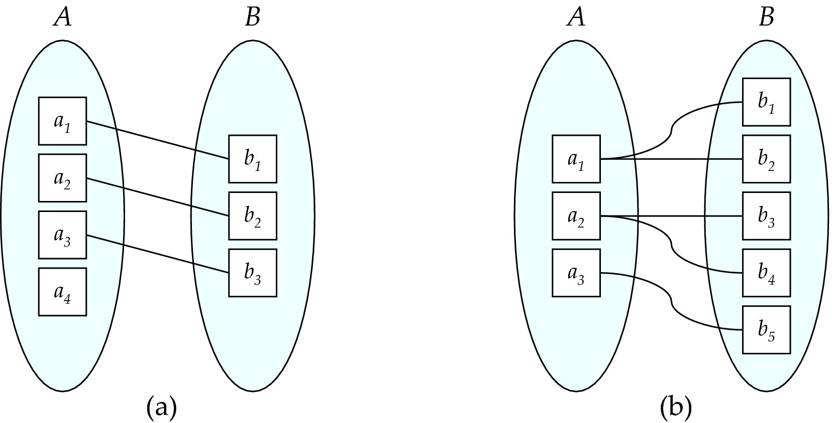
Mapping Cardinalities
One to one
One to many
Note: Some elements in A and B may not be mapped to any
elements in the other set

Slide 18
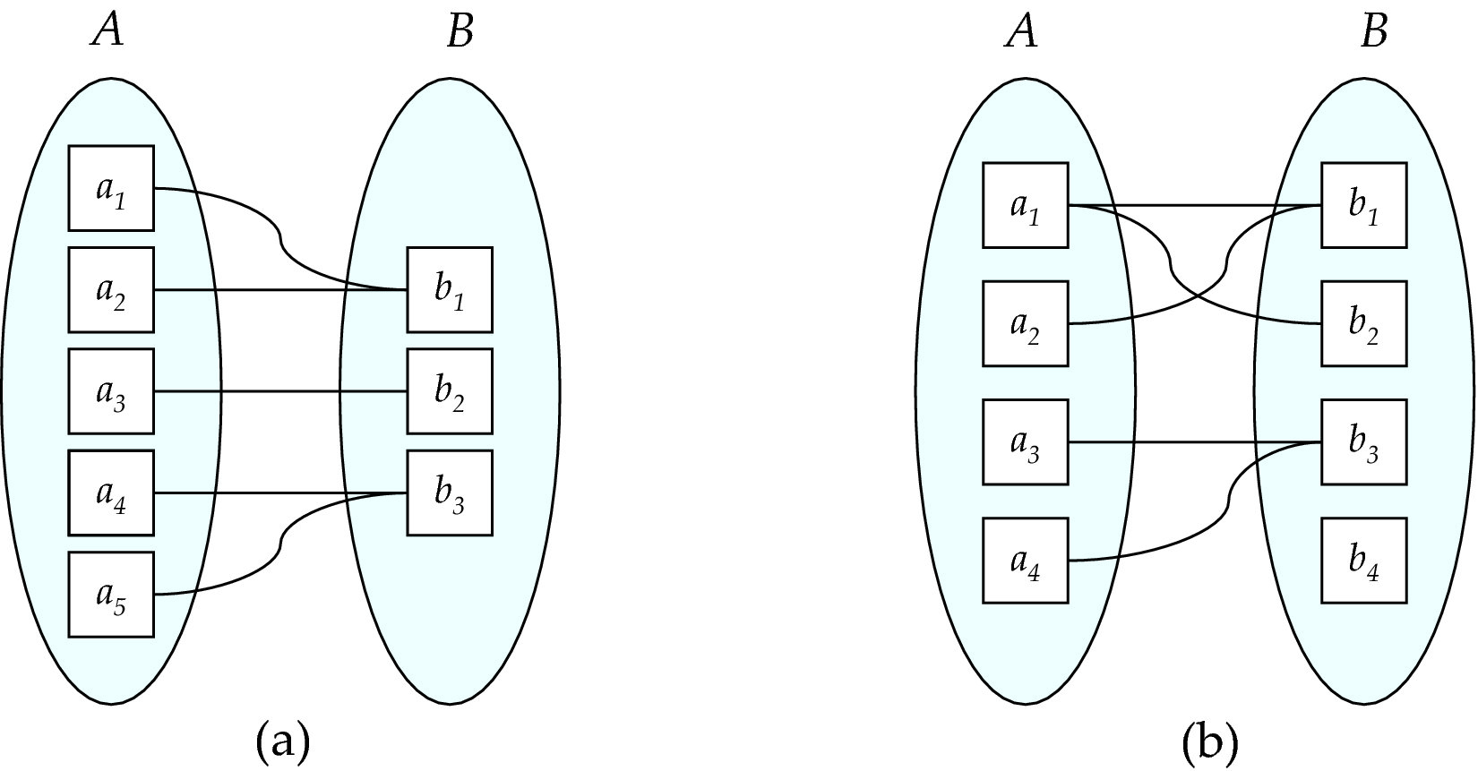
Mapping Cardinalities
Many to one
Many to many
Note: Some elements in A and B may not be mapped to any
elements in the other set

Slide 19
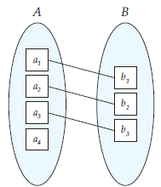
Participation Constraint
Total or partial
The participation of an entity set E in a relationship set R is said to be total if every entity in E participates in at least one relationship in R.
If only some entities in E participate in relationships in R, the participation of entity set E in relationship R is said to be partial.
In the figure below, the participation of B in the relationship set is total while the participation of A in the relationship set is partial.

Slide 20
Redundant Attributes
A good entity-relationship design does not contain redundant attributes.
Suppose we have entity sets:
instructor, with attributes: ID, name, dept_name, salary
department, with attributes: dept_name, building, budget
We model the fact that each instructor has an associated department using a relationship set inst_dept
The attribute dept_name appears in both entity sets. Since it is the primary key for the entity set department, it is redundant in the entity set instructor and needs to be removed.

Slide 21
Redundant Attributes
Removing the attribute dept_name from the instructor entity set may appear rather unintuitive, since the relation instructor that we used in the earlier chapter had an attribute dept_name.
As we shall see later, when we create a relational schema from the E-R diagram, the attribute dept_name in fact gets added to the relation instructor, but only if each instructor has at most one associated department.
If an instructor has more than one associated department, the relationship between instructors and departments is recorded in a separate relation inst_dept.

Slide 22
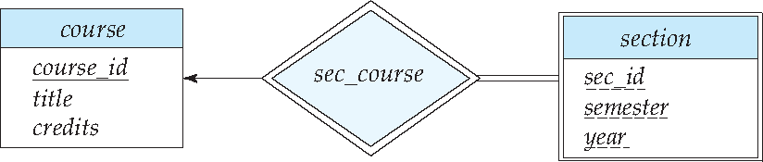
Weak Entity Sets
A weak entity set is the one whose existence is dependent on another entity set, called its identifying entity.
Example: section entity set is dependent on course entity set
The discriminator of a weak entity set is a set of attributes that allows us to distinguish between the weak entity sets that are dependent on one particular strong entity set.
A weak entity set does not have sufficient attributes to form a primary key. The primary key of a weak entity set is formed by the primary key of the identifying entity set, plus the weak entity set’s discriminator (also called partial key).
An entity set that is not a weak entity set is termed a strong entity set.
The relationship associating the weak entity set with the identifying entity set is called the identifying relationship.

Slide 23
E-R Diagrams

Slide 24
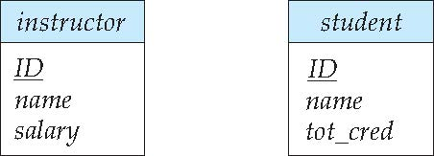
Entity Sets
Rectangles divided into two parts represent entity sets.
The first part contains the name of the entity set.
The second part contains the names of all the attributes of the entity set.
Attributes that are part of the primary key are underlined.

Slide 25
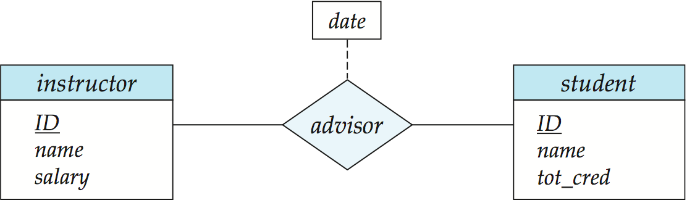
Relationship Sets
Diamonds represent relationship sets.
Lines link entity sets to relationship sets.
Dashed lines link attributes of a relationship set to the relationship set.
Undivided rectangles represent the attributes of a relationship set.

Slide 26
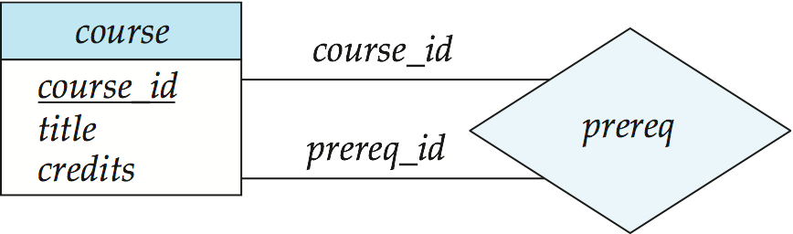
Roles
We indicate roles in E-R diagrams by labeling the lines that connect diamonds to rectangles.
The labels “course_id” and “prereq_id” are called roles.

Slide 27
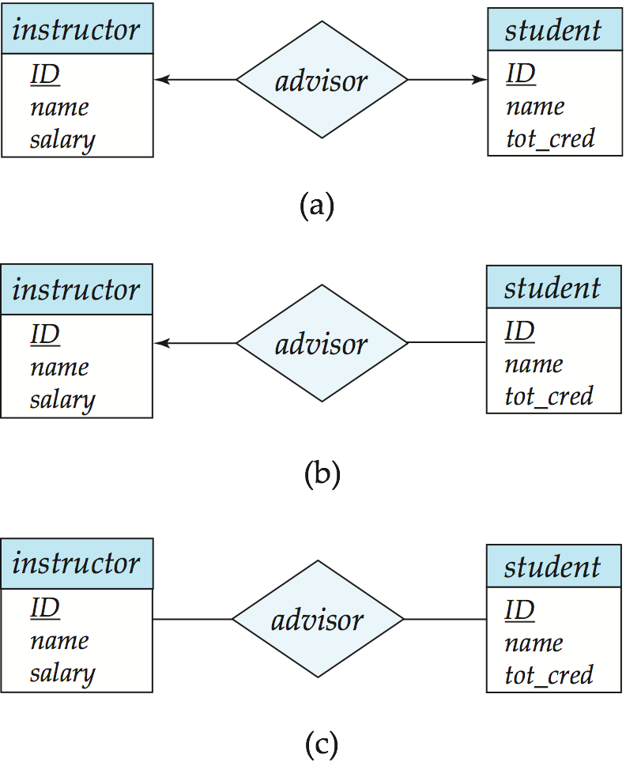
Cardinality Constraints
Mapping cardinalities, or cardinality ratios, express the number of entities to which another entity can be associated via a relationship set.
We express cardinality constraints by drawing either a directed line (→), signifying “one,” or an undirected line (—), signifying “many,” between the relationship set and the entity set.
One-to-one relationship indicates that an instructor may advise at most one student, and a student may have at most one advisor.

Slide 28

Cardinality Constraints Contd…
one-to-many relationship indicates that an instructor may advise many students, but a student may have at most one advisor.
many-to-one relationship indicates that an instructor may advise at most one student, but a student may have many advisors.

Slide 29
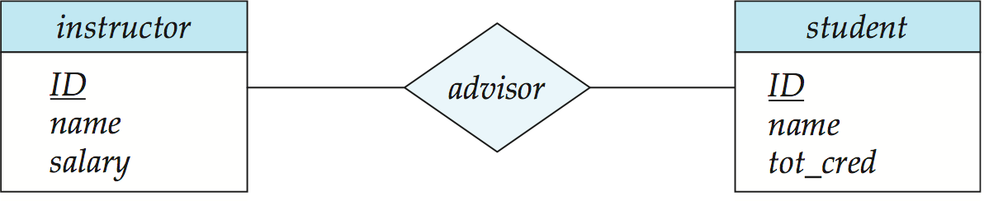
Cardinality Constraints Contd…
many-to-many relationship indicates that an instructor may advise many students, and a student may have many advisors.

Slide 30
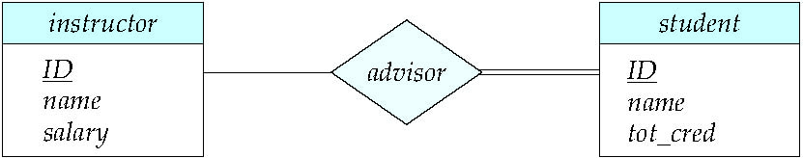
Total and Partial Participation
Total participation (indicated by double line): every entity in the entity set participates in at least one relationship in the relationship set
participation of student in advisor relation is total
every student must have an associated instructor
Partial participation: some entities may not participate in any relationship in the relationship set
Example: participation of instructor in advisor is partial

Slide 31
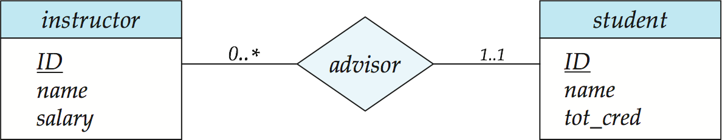
Notation for Expressing More Complex Constraints
A line may have an associated minimum and maximum cardinality, shown in the form l..h, where l is the minimum and h the maximum cardinality
A minimum value of 1 indicates total participation.
A maximum value of 1 indicates that the entity participates in at most one relationship
A maximum value of * indicates no limit.
Instructor can advise 0 or more students. A student must have 1 advisor; cannot have multiple advisors

Slide 32
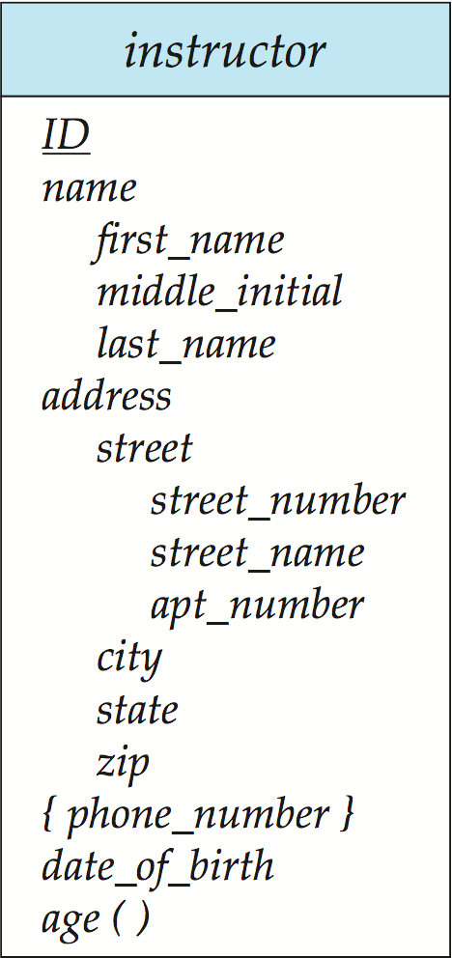
Notation to Express Entity with Complex Attributes
name and address are composite attributes
phone number is a multivalued attribute
age is a derived attribute

Slide 33
Expressing Weak Entity Sets
In E-R diagrams, a weak entity set is depicted via a double rectangle.
We underline the discriminator of a weak entity set with a dashed line.
The relationship set connecting the weak entity set to the identifying strong entity set is depicted by a double diamond.
The primary key of a weak entity set is formed by the primary key of the identifying entity set, plus the weak entity set’s discriminator (also called partial key).
Primary key for section – (course_id, sec_id, semester, year)
The double lines indicate the participation of the weak entity set section in the relationship sec_course to be total, meaning that every section must be related via sec_course to some course.
The arrow from sec_course to course indicates that each section is related to a single course.

Slide 34
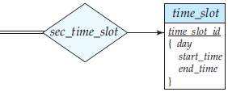
Expressing Weak Entity Sets Contd…
A weak entity set can participate in relationships other than the identifying relationship.
For instance, the section entity could participate in a relationship with the time slot entity set, identifying the time when a particular class section meets.
A weak entity set may participate as owner in an identifying relationship with another weak entity set.
It is also possible to have a weak entity set with more than one identifying entity set. The primary key of the weak entity set would consist of the union of the primary keys of the identifying entity sets, plus the discriminator of the weak entity set.

Slide 35
Expressing Weak Entity Sets Contd…
In some cases, the database designer may choose to express a weak entity set as a multivalued composite attribute of the owner entity set.
In our example, this alternative would require that the entity set course have a multivalued, composite attribute section.
A weak entity set may be more appropriately modeled as an attribute if it participates in only the identifying relationship, and if it has few attributes.
The section entity participates in two relationships and is modeled more aptly as a weak entity set.

Slide 36
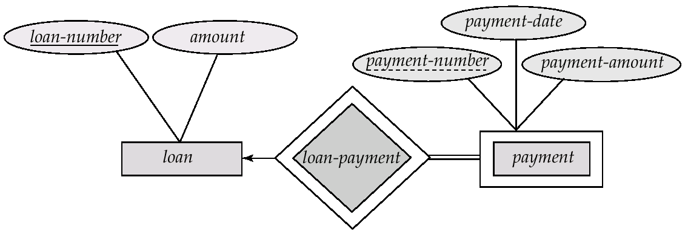
Weak Entity Sets
Another example
payment-number – discriminator of the payment entity set
Primary key for payment – (loan-number, payment-number)

Slide 37
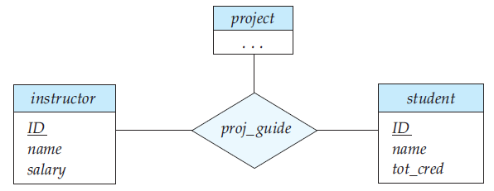
Ternary Relationships
Non-binary relationship sets can be specified easily in an E-R diagram as shown below.

Slide 38
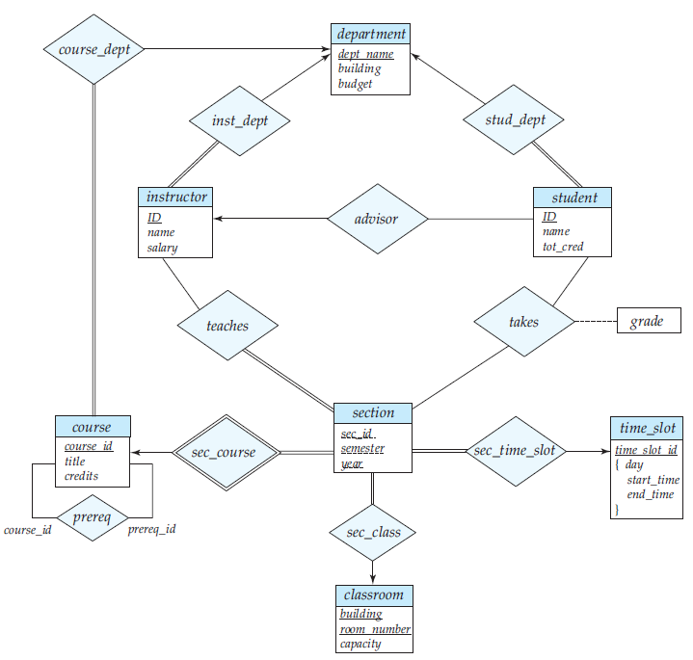
E-R Diagram for a University Enterprise

Slide 39
Practice Exercise 7.15
Construct an E-R diagram for a hospital with a set of patients and a set of medical doctors. Associate with each patient a log of the various tests and examinations conducted.

Slide 40
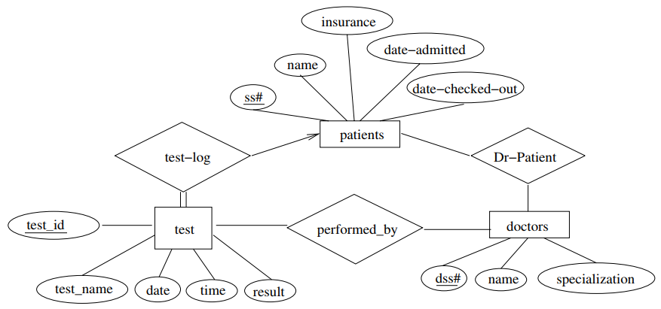
Practice Exercise Solution

Slide 41
Practice Exercise 7.3
Design an E-R diagram for keeping track of the exploits of your favorite sports team. You should store the matches played, the scores in each match, the players in each match, and individual player statistics for each match. Summary statistics should be modeled as derived attributes.

Slide 42
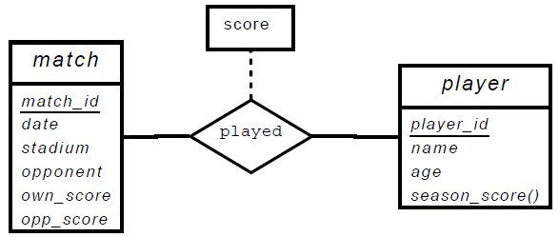
Practice Exercise Solution

Slide 43
Practice Exercise 7.1
Construct an E-R diagram for a car insurance company whose customers own one or more cars each. Each car has associated with it zero to any number of recorded accidents. Each insurance policy covers one or more cars, and has one or more premium payments associated with it. Each payment is for a particular period of time, and has an associated due date, and the date when the payment was received.

Slide 44
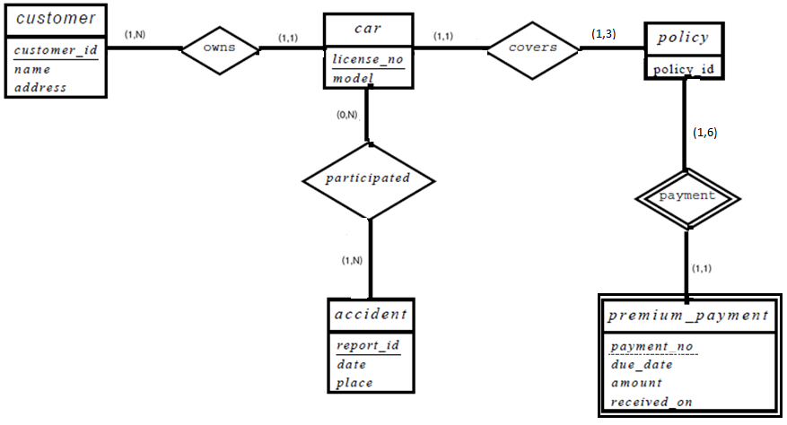
Practice Exercise Solution Using Min-Max

Slide 45
Practice Exercise 7.2
Consider a database used to record the marks that students get in different exams of different course offerings (sections).
Construct an E-R diagram that models exams as entities, and uses a ternary relationship, for the database.

Slide 46
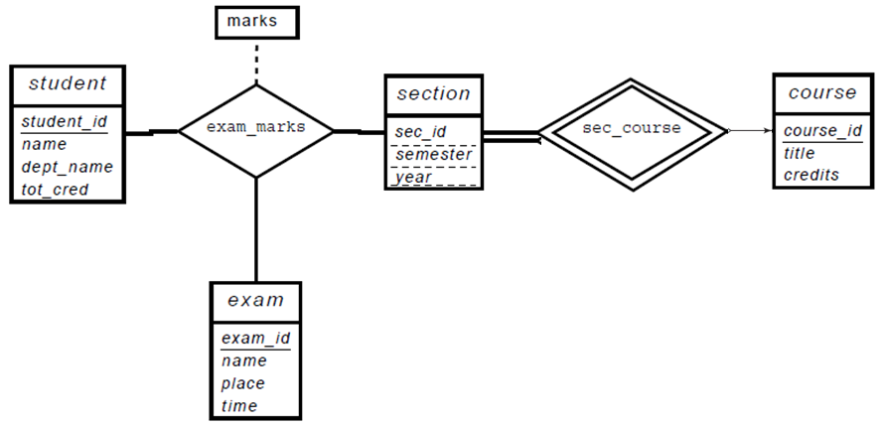
Practice Exercise Solution

Slide 47
Practice Exercise 7.2
Construct an alternative E-R diagram for the previous problem that uses only a binary relationship between student and section.

Slide 48
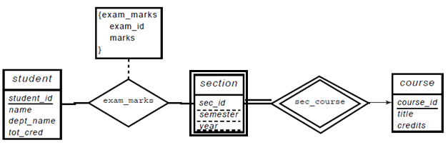
Practice Exercise Solution

Slide 49
Reduction to Relation Schemas

Slide 50
Reduction to Relation Schemas
Step 1: Mapping of Regular Entity Types
For each regular entity type E, create a relation R that includes all the simple attributes of E
student(ID, name, tot_cred)

Slide 51
Reduction to Relation Schemas
Step 2: Mapping of Weak Entity Types
For each weak entity type, create a relation R and include all simple attributes of the weak entity type as attributes of R
Include primary key attribute of owner as foreign key attributes of R
The primary key of this relation R is the discriminator plus the primary key of owner entity.
section ( course_id, sec_id, sem, year )

Slide 52
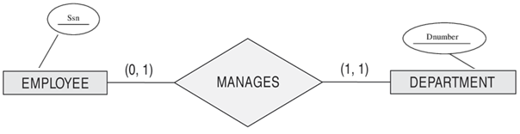
Reduction to Relation Schemas
Step 3: Mapping of Binary 1:1 Relationship Types
For each binary 1:1 relationship type R
Identify the entities S and T participating in R
Choose S as the entity with total participation (Department in our example)
Include as a foreign key in S the primary key of T (So, SSN will be included in Department as foreign key)
Also, include all the simple attributes of the relationship R as attributes of S
Department (dNumber, SSN)

Slide 53

Reduction to Relation Schemas
Step 4: Mapping of Binary 1:N Relationship Types
For each regular binary 1:N relationship type R
Identify the entity S at N-side of relationship type
Include primary key of T as foreign key in S
Include simple attributes of 1:N relationship R as attributes of S
Example: stud_dept is a 1:N relationship with student being on the N side and department being on the 1 side of the relationship. So, add an attribute dept_name to the schema arising from entity set student.
student(ID, name, tot_cred, dept_name)

Slide 54

Reduction to Relation Schemas
Note on Step 4: Mapping of Binary 1:N Relationship Types
The advisor relationship is 1:N with student being on the N side.
So, we could model the relationship advisor by adding I_ID as a foreign key in student.
But, since student is not in total participation, some students may not have advisor and hence will have null values for I-ID.
The example in the book follows a different approach to avoid the null values and just creates a new relation for the advisor relationship with the attributes of this relation being the primary keys of instructor and student.
advisor(s_id, i_id)
However, both the above approaches are correct.

Slide 55
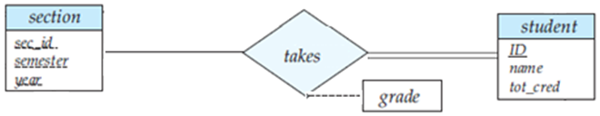
Reduction to Relation Schemas
Step 5: Mapping of Binary M:N Relationship Types
For each binary M:N relationship type R
Create a new relation S
Include primary key of participating entity types as foreign key attributes in S (these will also act as the primary key of S)
Include any simple attributes of M:N relationship type R
Example:
takes(ID, course id, sec id, semester, year, grade)

Slide 56

Reduction to Relation Schemas
Step 6: Mapping of Multivalued Attributes
For each multivalued attribute A
Create a new relation R
The new relation R includes the multivalued attribute A and the primary key K of the entity as a foreign key in R
Primary key of R is the combination of A and K
Example: time_slot(time_slot_id, day, start_time, end_time)
Important Note: The above relation is for the multivalued attribute and not for the time_slot entity.

Slide 57
Reduction to Relation Schemas
Step 6: Mapping of Multivalued Attributes Continued
Example: time_slot(time_slot_id, day, start_time, end_time)
Important Note: The above relation is for the multivalued attribute.
For the time_slot entity, we create a new relation which includes all attributes other than the multivalued attribute. In this example, the only other attribute is the primary key resulting in a relation:
time_slot_relation(time_slot_id)
Since this relation is redundant, we don’t include it in the final schema.

Slide 58
Reduction to Relation Schemas
Step 6: Mapping of Multivalued Attributes
Another example:
Consider the following entity with id being the primary key and locations being a multivalued attribute
department(id, name, {locations})
The above entity will result in two relations:
For the locations attribute: locations(id, locations)
For the department entity: department(id, name)

Slide 59
Reduction to Relation Schemas
Step 6: Mapping of Multivalued Attributes
Example with different attribute types
Composite attributes are handled by creating a separate attribute for each of the component attributes; we do not create a separate attribute for the composite attribute itself.
instructor(ID, first_name, middle_initial, last_name, street_number, street_name, apt_number, city, state, zip_code, date_of_birth)
inst_phone(ID, phone_number)
Derived attributes are not explicitly represented in the relational data model.
Notes:
59

Slide 60
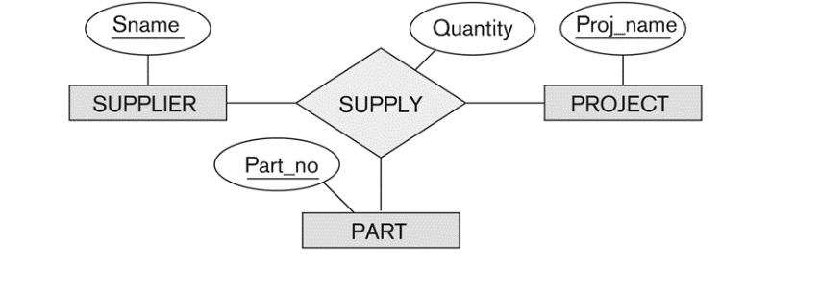
Reduction to Relation Schemas
Step 7: Mapping of N-ary Relationship Types
For each n-ary relationship type R
Create a new relation S to represent relationship R
Include primary keys of participating entity types as foreign keys in S (these together form the primary key of S)
Include any simple attributes of R as attributes of S
SUPPLIER PROJECT
PART
SUPPLY
Sname
Proj_name
Part_no
Sname | Proj_name | Part_no | Quantity

Slide 61
E-R Diagram for a University Enterprise
Please convert this ER diagram to a schema diagram.

Slide 62
End of Chapter 7

